Slide 1

Artificial Intelligence for Games
Speaker: Junghwan(John) Lee

Slide 2
Industrial Revolutions
Steam-powered machines
Mass production

Slide 3
Industrial Revolutions
Made physical work easier to do!
Steam-powered machines
Mass production

Slide 4
Industrial Revolutions
What’s next?

Slide 5
Industrial Revolutions
What’s next?
Time to make mental work easier to do!
Using AIs!

Slide 6
What’s next?
You probably know that AI is important

Slide 7
What’s next?
You probably know that AI is important
AI, Machine Learning, Tensorflow, Torch, etc…

Slide 8
What’s next?
You probably know that AI is important
AI, Machine Learning, Tensorflow, Torch, etc…
But do you know how exactly an AI works?

Slide 9
What’s next?
You probably know that AI is important
AI, Machine Learning, Tensorflow, Torch, etc…
But do you know how exactly an AI works?
Well, it’s time to get to learn how simple AIs work with Chess!

Slide 10
Overview
General Concepts for a Simple AI
-- Trees
-- Heuristics
-- MiniMax Algorithm
2. Making our AI smarter
-- Depth
-- Pruning
Extra: Making our AI even smarter
-- Machine Learning

Slide 11
Trees!

Slide 19
These trees will be our ‘data structure’ for the AI!

Slide 20
These trees will be our ‘data structure’ for the AI!
Okay, what do you mean by ‘data structure’?

Slide 21
Let’s imagine it this way:
White goes first

Slide 22
Let’s imagine it this way:
White goes first

Slide 23
Let’s imagine it this way:
White goes first

Slide 24
Let’s imagine it this way:
White goes first

Slide 25
Let’s imagine it this way:
White goes first

Slide 26
Let’s imagine it this way:
2
4
6
…
16
1
2
3
4
5
16
…
1
3
5
…
15
S
Start

Slide 27
Let’s imagine it this way:
Black’s turn
1
2
3
4
5
…
16
S
Start

Slide 28
Let’s imagine it this way:
1
…
16
1
16
…
…
1
2
3
4
5
…
16
S
Start

Slide 29
Let’s imagine it this way:
…
…
1
…
16
1
16
…
…
1
2
3
4
5
…
16
S
Start

Slide 30
1
…
N
This tree, when continued, will represent every combination of the Chess game!
1
…
N
…
1
…
N
1
…
16
1
16
…
…
1
2
3
4
5
…
16
S
Start

Slide 31
1
…
N
This tree, when continued, will represent every combination of the Chess game!
1
…
N
…
1
…
N
1
…
16
1
16
…
…
Branches = Each move
Circles = Board State
1
2
3
4
5
…
16
S
Start

Slide 32
Branches = Each Move
Circles = Board State
…
…
1
…
16
1
16
…
…
1
2
3
4
5
…
16
S
Start

Slide 33
Branches = Each Move
Circles = Board State
S
Start

Slide 34
Branches = Each Move
Circles = Board State
4
White pawn moves
S

Slide 35
Branches = Each Move
Circles = Board State
9
Black pawn moves
4
S

Slide 36
Branches = Each Move
Circles = Board State
8
White pawn moves
9
4
S

Slide 37
S
List of possible moves
1 | 2 | 3 | 4 | 5 | 6 | 7 | 8 | 9 | 10 | 11 | 12 | 13 | 14 | 15 | 16
1
2
3
4
5
…
16
S
Start

Slide 38
S
List of possible moves
1 | 2 | 3 | 4 | 5 | 6 | 7 | 8 | 9 | 10 | 11 | 12 | 13 | 14 | 15 | 16
…
1 | 2 | 3 | 4 | 5 | 6 | 7 | 8 | 9 | 10 | 11 | 12 | 13 | 14 | 15 | 16
1 | 2 | 3 | 4 | 5 | 6 | 7 | 8 | 9 | 10 | 11 | 12 | 13 | 14 | 15 | 16
1
…
16
1
16
…
…
1
2
3
4
5
…
16
S
Start

Slide 39
S
List of possible moves
1 | 2 | 3 | 4 | 5 | 6 | 7 | 8 | 9 | 10 | 11 | 12 | 13 | 14 | 15 | 16
…
1 | 2 | 3 | 4 | 5 | 6 | 7 | 8 | 9 | 10 | 11 | 12 | 13 | 14 | 15 | 16
1 | 2 | 3 | 4 | 5 | 6 | 7 | 8 | 9 | 10 | 11 | 12 | 13 | 14 | 15 | 16
1 | ... | N
1 | ... | N
1 | ... | N

Slide 40
S
List of possible moves
1 | 2 | 3 | 4 | 5 | 6 | 7 | 8 | 9 | 10 | 11 | 12 | 13 | 14 | 15 | 16
…
1 | 2 | 3 | 4 | 5 | 6 | 7 | 8 | 9 | 10 | 11 | 12 | 13 | 14 | 15 | 16
1 | 2 | 3 | 4 | 5 | 6 | 7 | 8 | 9 | 10 | 11 | 12 | 13 | 14 | 15 | 16
1 | ... | N
1 | ... | N
1 | ... | N

Slide 41
S
List of possible moves
1 | 2 | 3 | 4 | 5 | 6 | 7 | 8 | 9 | 10 | 11 | 12 | 13 | 14 | 15 | 16
…
1 | 2 | 3 | 4 | 5 | 6 | 7 | 8 | 9 | 10 | 11 | 12 | 13 | 14 | 15 | 16
1 | 2 | 3 | 4 | 5 | 6 | 7 | 8 | 9 | 10 | 11 | 12 | 13 | 14 | 15 | 16
1 | ... | N
1 | ... | N
1 | ... | N
1 | ... | N
It goes on and on
1 | ... | N
1 | ... | N

Slide 42
S
List of possible moves
1 | 2 | 3 | 4 | 5 | 6 | 7 | 8 | 9 | 10 | 11 | 12 | 13 | 14 | 15 | 16
…
1 | 2 | 3 | 4 | 5 | 6 | 7 | 8 | 9 | 10 | 11 | 12 | 13 | 14 | 15 | 16
1 | 2 | 3 | 4 | 5 | 6 | 7 | 8 | 9 | 10 | 11 | 12 | 13 | 14 | 15 | 16
1 | ... | N
1 | ... | N
1 | ... | N
1 | ... | N
1 | ... | N
1 | ... | N
If we create an AI using just what we have right now

Slide 43
S
WHITE = Human, BLACK = AI
1 | 2 | 3 | 4 | 5 | 6 | 7 | 8 | 9 | 10 | 11 | 12 | 13 | 14 | 15 | 16
…
1 | 2 | 3 | 4 | 5 | 6 | 7 | 8 | 9 | 10 | 11 | 12 | 13 | 14 | 15 | 16
1 | 2 | 3 | 4 | 5 | 6 | 7 | 8 | 9 | 10 | 11 | 12 | 13 | 14 | 15 | 16
1 | ... | N
1 | ... | N
1 | ... | N
1 | ... | N
1 | ... | N
1 | ... | N
If we create an AI using just what we have right now

Slide 44
S
WHITE = Human, BLACK = AI
1 | 2 | 3 | 4 | 5 | 6 | 7 | 8 | 9 | 10 | 11 | 12 | 13 | 14 | 15 | 16
…
RANDOM!
1 | 2 | 3 | 4 | 5 | 6 | 7 | 8 | 9 | 10 | 11 | 12 | 13 | 14 | 15 | 16
1 | 2 | 3 | 4 | 5 | 6 | 7 | 8 | 9 | 10 | 11 | 12 | 13 | 14 | 15 | 16
1 | ... | N
1 | ... | N
1 | ... | N
1 | ... | N
1 | ... | N
1 | ... | N
If we create an AI using just what we have right now

Slide 45
S
WHITE = Human, BLACK = AI
1 | 2 | 3 | 4 | 5 | 6 | 7 | 8 | 9 | 10 | 11 | 12 | 13 | 14 | 15 | 16
…
1 | 2 | 3 | 4 | 5 | 6 | 7 | 8 | 9 | 10 | 11 | 12 | 13 | 14 | 15 | 16
1 | 2 | 3 | 4 | 5 | 6 | 7 | 8 | 9 | 10 | 11 | 12 | 13 | 14 | 15 | 16
1 | ... | N
1 | ... | N
1 | ... | N
1 | ... | N
1 | ... | N
1 | ... | N
If we create an AI using just what we have right now

Slide 46
S
WHITE = Human, BLACK = AI
1 | 2 | 3 | 4 | 5 | 6 | 7 | 8 | 9 | 10 | 11 | 12 | 13 | 14 | 15 | 16
…
1 | 2 | 3 | 4 | 5 | 6 | 7 | 8 | 9 | 10 | 11 | 12 | 13 | 14 | 15 | 16
1 | 2 | 3 | 4 | 5 | 6 | 7 | 8 | 9 | 10 | 11 | 12 | 13 | 14 | 15 | 16
1 | ... | N
1 | ... | N
1 | ... | N
1 | ... | N
1 | ... | N
1 | ... | N
If we create an AI using just what we have right now

Slide 47
S
WHITE = Human, BLACK = AI
1 | 2 | 3 | 4 | 5 | 6 | 7 | 8 | 9 | 10 | 11 | 12 | 13 | 14 | 15 | 16
…
1 | 2 | 3 | 4 | 5 | 6 | 7 | 8 | 9 | 10 | 11 | 12 | 13 | 14 | 15 | 16
1 | 2 | 3 | 4 | 5 | 6 | 7 | 8 | 9 | 10 | 11 | 12 | 13 | 14 | 15 | 16
1 | ... | N
1 | ... | N
1 | ... | N
1 | ... | N
RANDOM!
1 | ... | N
1 | ... | N
If we create an AI using just what we have right now

Slide 48
S
WHITE = Human, BLACK = AI
1 | 2 | 3 | 4 | 5 | 6 | 7 | 8 | 9 | 10 | 11 | 12 | 13 | 14 | 15 | 16
…
1 | 2 | 3 | 4 | 5 | 6 | 7 | 8 | 9 | 10 | 11 | 12 | 13 | 14 | 15 | 16
1 | 2 | 3 | 4 | 5 | 6 | 7 | 8 | 9 | 10 | 11 | 12 | 13 | 14 | 15 | 16
1 | ... | N
1 | ... | N
1 | ... | N
1 | ... | N
RANDOM!
1 | ... | N
1 | ... | N
Usually, randomness isn’t too intelligent

Slide 49
S
WHITE = Human, BLACK = AI
1 | 2 | 3 | 4 | 5 | 6 | 7 | 8 | 9 | 10 | 11 | 12 | 13 | 14 | 15 | 16
…
1 | 2 | 3 | 4 | 5 | 6 | 7 | 8 | 9 | 10 | 11 | 12 | 13 | 14 | 15 | 16
1 | 2 | 3 | 4 | 5 | 6 | 7 | 8 | 9 | 10 | 11 | 12 | 13 | 14 | 15 | 16
1 | ... | N
1 | ... | N
1 | ... | N
1 | ... | N
RANDOM!
1 | ... | N
1 | ... | N
So, we need to create a logic for the AI to follow

Slide 50
Heuristics & Minimax Algorithms

Slide 51
Computers usually follow a True/False logic

Slide 52
Computers usually follow a True/False logic
2 > 1 True!
100 < 103 True!
-1 = 1 False!

Slide 53
Computers usually follow a True/False logic
2 > 1 True!
100 < 103 True!
-1 = 1 False!
Carrot > Mushroom ??
Rabbits = Hamsters ??
Smile Face > Angry Face ??

Slide 54
Computers usually follow a True/False logic
2 > 1 True!
100 < 103 True!
-1 = 1 False!
Carrot > Mushroom ??
Rabbits = Hamsters ??
Smile Face > Angry Face ??
In order for computers to follow a true/false logic,
we need to assign numbers for the computer to compare

Slide 55
Computers usually follow a True/False logic
2 > 1 True!
100 < 103 True!
-1 = 1 False!
Smile Face = 100 Happiness
Angry Face = -100 Happiness
Smile Face > Angry Face True!
In order for computers to follow a true/false logic,
we need to assign numbers for the computer to compare

Slide 56
Computers usually follow a True/False logic
2 > 1 True!
100 < 103 True!
-1 = 1 False!
Smile Face = 100 Happiness
Angry Face = -100 Happiness
Smile Face > Angry Face True!
Heuristics
Assigning numbers to unquantifiable objects using our own logic

Slide 57
Heuristics in Chess!
Your Checkmate: Awesome!
Opponent’s Checkmate: Awful ☹

Slide 58
Heuristics in Chess!
Your Checkmate: Awesome!
Positive Infinity
Opponent’s Checkmate: Awful ☹
Negative Infinity

Slide 59
Heuristics in Chess!
You are about to eliminate the opponent’s Queen:
Great!
Opponent is about to eliminate your Queen:
Not good ☹

Slide 60
Heuristics in Chess!
You are about to eliminate the opponent’s Queen:
Great!
1000
Opponent is about to eliminate your Queen:
Not good ☹
-1000

Slide 61
Heuristics in Chess!
You eliminate a pawn: 100
You eliminate a bishop: 350
You eliminate a rook: 500
You eliminate the queen: 1000
You elimiante the king: ∞
…
Opponent eliminates a pawn: -100
Opponent eliminates a bishop: -350
Opponent eliminates a rook: -500
Opponent eliminates the queen: -1000
Opponent elimiantes the king: -∞
…
This is up to who creates the AI

Slide 62
Heuristics in Chess!
You eliminate a pawn: 100
You eliminate a bishop: 350
You eliminate a rook: 500
You eliminate the queen: 100
You elimiante the king: ∞
…
Opponent eliminates a pawn: -100
Opponent eliminates a bishop: -350
Opponent eliminates a rook: -500
Opponent eliminates the queen: -100
Opponent elimiantes the king: -∞
…
This is up to who creates the AI
If you think the queen isn’t so important, this would be your heuristics

Slide 63
Heuristics in Chess!
You eliminate a pawn: 100
You eliminate a bishop: 350
You eliminate a rook: 500
You eliminate the queen: 100
You elimiante the king: ∞
…
Opponent eliminates a pawn: -100
Opponent eliminates a bishop: -350
Opponent eliminates a rook: -500
Opponent eliminates the queen: -100
Opponent elimiantes the king: -∞
…
But this isn’t the end…

Slide 64
Heuristics in Chess!
Your pawn is 2 moves from killing the queen: 300
Your pawn is 3 moves from killing the queen: 50
Your pawn is 4 moves from killing the queen: 5
Your pawn is 5 moves from killing the queen: 2
Your pawn is 6 moves from killing the queen: 1
…
We also have futuristic heuristics!

Slide 65
Heuristics in Chess!
Your pawn blocks the way for the opponents pawn: 40
Your knight can only move to 2 spots (instead of 8): -60
Your pawn opens up a road for the rook to travel: 200
…
P
P
P
P
P
P
And locational heuristics as well!

Slide 66
Heuristics in Chess!
Your pawn blocks the way for the opponents pawn: 20
Your knight can only move to 2 spots (instead of 8): -30
Your pawn opens up a road for the rook to travel: 200
…
P
P
P
P
P
P
We have locational heuristics as well!
+ even more that I couldn’t think of

Slide 67
Heuristics in Chess!
How ‘smart’ the AI comes from how well you design your heuristics
A lot of people write research papers on this topic!

Slide 68
Back to our tree!
Branches = Each Move
Circles = Board State

Slide 69
Back to our tree!
Branches = Each Move
Circles = Board State
2
1

Slide 70
Back to our tree!
Branches = Each Move
Circles = Board State
Opens way for the
rook to move
Blocks knight’s path
1
(-10)
2
(+40)
2
1
S
Start

Slide 71
MiniMax Algorithm
Branches = Each Move
Circles = Board State
1
(-10)
2
(+200)
2
1
S
Start

Slide 72
MiniMax Algorithm
Branches = Each Move
Circles = Board State
Blocks Knight’s way
and exposes King
1
(-80)
2
(-60)
1
2
2
(+200)
S
Start

Slide 73
MiniMax Algorithm
Branches = Each Move
Circles = Board State
Exposes King
1
(-80)
2
(-60)
1
2
2
(+200)
S
Start

Slide 74
Back to our tree!
Both are bad, but -60 > -80
1
(-80)
2
(-60)
1
2
2
(+200)
S
Start

Slide 75
MiniMax Algorithm
The computer will choose the ‘best’ option according to our heuristics
M
(+b)
N
(+a)
2
(-60)
2
(+200)
S
Start

Slide 76
MiniMax Algorithm
+50
+80
-20
+10
+200
+20
+1000
-30
-80
+70

Slide 77
MiniMax Algorithm
+50
+80
-20
+10
+200
+20
+1000
-30
-80
+70

Slide 78
MiniMax Algorithm
+50
+80
-20
+10
+200
+20
+1000
-30
-80
+70
Each player will choose the ‘best’ option!
Hence the name, mini-max algorithm

Slide 79
MiniMax Algorithm
+50
MAX
MIN
+80
-20
+10
+200
+20
+1000
-30
-80
+70
Each player will choose the ‘best’ option!
Hence the name, mini-max algorithm
MAX

Slide 80
MiniMax Algorithm
+50
+80
-20
+10
+200
+20
+1000
-30
-80
+70

Slide 81
MiniMax Algorithm
+50
+80
-20
+10
+200
+20
+1000
-30
-80
+70
+20
+ ∞
+30
-80
+0
+100

Slide 82
Back to our tree!
+50
+80
-20
+10
+200
+20
+1000
-30
-80
+70
+20
+ ∞
+30
-80
+0
+100
Uh-oh
You eliminated the opponent’s Queen, but you got checkmated

Slide 83
MiniMax Algorithm
Depth Sensing
+50
Depth: 4
+80
-20
+10
+200
+20
+1000
-30
-80
+70
+20
+ ∞
+30
-80
+0
+100
Total: 50 – 80 + 200 – 20 = 150

Slide 84
MiniMax Algorithm
Depth Sensing
+50
Depth: 4
+80
-20
+10
+200
+20
+1000
-30
-80
+70
+20
+ ∞
+30
-80
+0
+100
Total: 150

Slide 85
MiniMax Algorithm
Depth Sensing
+50
Depth: 4
+80
-20
+10
+200
+20
+1000
-30
-80
+70
+20
+ ∞
+30
-80
+0
+100
Total: 150
Total: - ∞

Slide 86
MiniMax Algorithm
Depth Sensing
+50
Depth: 4
+80
-20
+10
No
+200
+20
+1000
-30
-80
+70
+20
+ ∞
+30
-80
+0
+100
Total: 150
Total: - ∞

Slide 87
MiniMax Algorithm
Depth Sensing
+50
Depth: 4
+80
-20
+10
+200
+20
+1000
-30
-80
+70
+20
+ ∞
+30
-80
+0
+100
Total: 150
Total: - ∞

Slide 88
MiniMax Algorithm
Depth Sensing
+50
Depth: 4
No
+80
-20
+10
+200
+20
+1000
-30
-80
+70
+20
+ ∞
+30
-80
+0
+100
Total: 150
Total: - ∞

Slide 89
MiniMax Algorithm
Depth Sensing
+50
Depth: 4
+80
-20
+10
+200
+1000
-30
-80
+70
+20
+ ∞
+30
-80
+0
+100
Total: 150
Total: - ∞
Total: 10

Slide 90
MiniMax Algorithm
Depth Sensing
+50
Depth: 4
+80
-20
+10
+200
+1000
-30
-80
+70
+20
+ ∞
+30
-80
+0
+100
Total: 150
Total: - ∞
Total: 10
Total: 40
Total: -40
Total: 10

Slide 91
MiniMax Algorithm
Depth Sensing
+50
Depth: 4
+80
-20
+10
+200
+1000
-30
-80
+70
+20
+ ∞
+30
-80
+0
+100
Total: 150
Total: - ∞
Total: 10
Total: 40
Total: -40
Total: 10

Slide 92
MiniMax Algorithm
Depth Sensing
+50
Depth: 4
+80
+200
+20
+20

Slide 93
MiniMax Algorithm
Depth Sensing
+50
Depth: 4
+80
The deeper the depth, the ‘smarter’ the AI is!
+200
Eg) We wouldn’t have known that +1000 was in fact a bad move
+20
+1000
+20
+ ∞

Slide 94
MiniMax Algorithm
Depth Sensing
+50
Depth: 4
+80
The deeper the depth, the ‘smarter’ the AI is!
Optimal Case: Infinite Depth
But is this possible?
+200
+20
+20

Slide 95
MiniMax Algorithm
Depth Sensing
+50
Depth: 4
+80
The deeper the depth, the ‘smarter’ the AI is!
Optimal Case: Infinite Depth
But is this possible?
No. Why?
+200
+20
+20

Slide 96
MiniMax Algorithm
Depth Sensing
Start
S
A
B
C
…

Slide 97
MiniMax Algorithm
Depth Sensing
Branches = Each Move
Circles = Board State
Start
S
A
B
C
…
A LOT of new combinations/possibilities!

Slide 98
MiniMax Algorithm
Depth Sensing
Branches = Each Move
Circles = Board State
Start
S
A
B
C
…
A LOT of new combinations/possibilities!
Our tree will get pretty large!

Slide 99
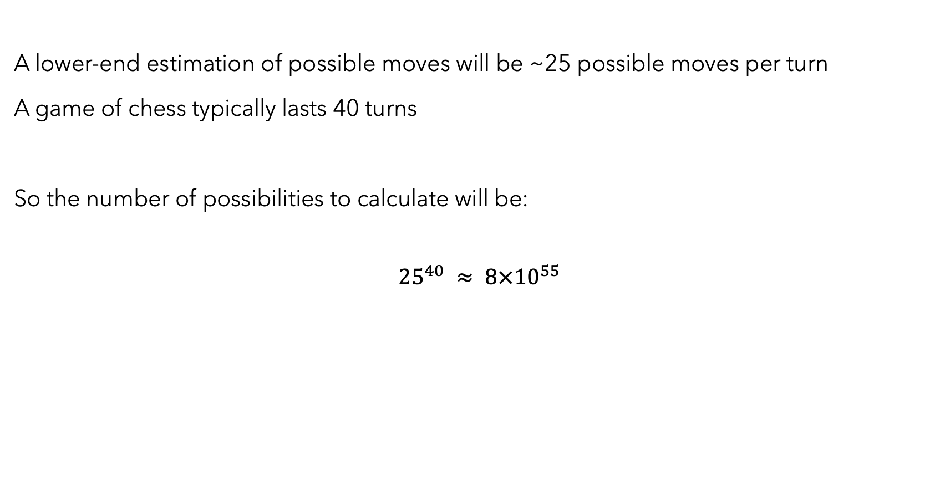
A lower-end estimation of possible moves will be ~25 possible moves per turn
A game of chess typically lasts 40 turns
So the number of possibilities to calculate will be:
$${25}^{40} ≈ 8×{10}^{55}$$

Slide 100
A lower-end estimation of possible moves will be ~25 possible moves per turn
A game of chess typically lasts 40 turns
So the number of possibilities to calculate will be:
$${25}^{40} ≈ 8×{10}^{55}$$
That’s a pretty big size!

Slide 101
A lower-end estimation of possible moves will be ~25 possible moves per turn
A game of chess typically lasts 40 turns
So the number of possibilities to calculate will be:
$${25}^{40} ≈ 8×{10}^{55}$$
That’s a pretty big size!
Our computers cannot handle this much!

Slide 102
A lower-end estimation of possible moves will be ~25 possible moves per turn
A game of chess typically lasts 40 turns
So the number of possibilities to calculate will be:
$${25}^{40} ≈ 8×{10}^{55}$$
That’s a pretty big size!
Our computers cannot handle this much!
Assuming calculating heuristics for each move is 80 Bytes, that is at least ${10}^{45}$ Gigabytes

Slide 103
So what do we do?
Unfortunately, we have to limit our depth to 6~7 for a normal computer
BUT the depth varies significantly depending on the game and the heuristics you build.

Slide 104
Quick
Summary

Slide 105
Trees

Slide 106
Using trees to represent Chess
…
…
1
…
16
1
16
…
…
1
2
3
4
5
…
16
S
Start

Slide 107
Heuristics
You eliminate a pawn: 100
You eliminate a bishop: 350
You eliminate a rook: 500
You eliminate the queen: 1000
You elimiante the king: ∞
…
Opponent eliminates a pawn: -100
Opponent eliminates a bishop: -350
Opponent eliminates a rook: -500
Opponent eliminates the queen: -1000
Opponent elimiantes the king: -∞
…

Slide 108
Using heuristics to find path
1
(-10)
2
(+200)
S
Start

Slide 109
Mini-max algorithm
+50
MAX
MIN
+80
-20
+10
+200
+1000
-30
-80
+70

Slide 110
Finding optimal path using depth
+50
Depth: 4
No
No
+80
-20
+10
No
+200
+1000
-30
-80
+70
+20
+ ∞
+30
-80
+0
+100
Total: 150

Slide 111
Methods to make the ai ‘smarter’
Create better heuristics
Increase the search depth

Slide 112
Questions

Slide 114
Extra: Machine learning

Slide 115
So what do we do?
Unfortunately, we have to limit our depth to 6~7 for a normal computer

Slide 116
So what do we do?
Unfortunately, we have to limit our depth to 6~7 for a normal computer
But there is hope!

Slide 117
So what do we do?
Unfortunately, we have to limit our depth to 6~7 for a normal computer
But there is hope!
We can use Machine Learning!

Slide 118
Extra: Machine Learning
Very Simple
Objective: Make the machine learn!

Slide 119
Extra: Machine Learning
Very Simple
Objective: Make the machine learn! (through correlation)

Slide 120
Extra: Machine Learning
Very Simple
Objective: Make the machine learn! (through correlation)
Correlation Example) Love for chocolate has a positive effect on coding abilities

Slide 121
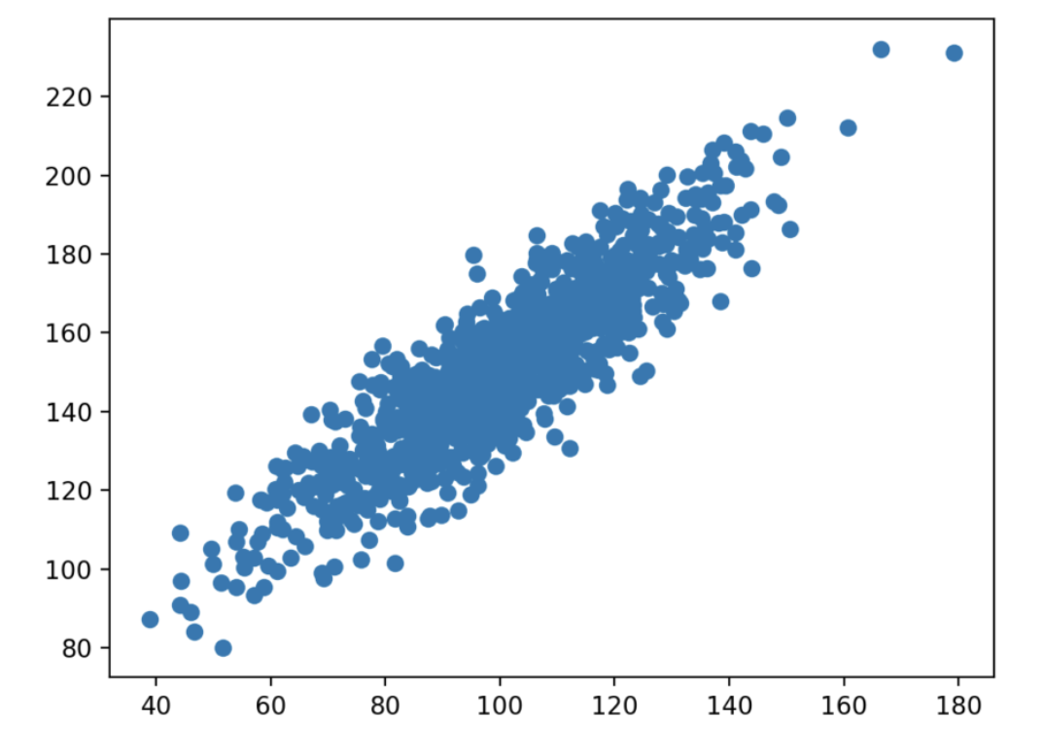
Extra: Machine Learning
Very Simple
Objective: Make the machine learn! (through correlation)
Correlation Example) Love for chocolate has a positive effect on coding abilities
Assuming we conducted random experiments
Coding Ability
Love for chocolate

Slide 122
Extra: Machine Learning
Very Simple
Objective: Make the machine learn! (through correlation)
Correlation Example) Love for chocolate has a positive effect on coding abilities
Assuming we conducted random experiments
Coding Ability
Coding Ability = Love for Chocolate + 40
Love for chocolate

Slide 123
Extra: Machine Learning
Very Simple
Objective: Make the machine learn! (through correlation)
In our case) We want to create the perfect heuristics for the AI by examining how significantly each move effects the result of the game

Slide 124
There are many ways to do this, but here’s a simple example method

Slide 125
There are many ways to do this, but here’s a simple example method
You elimiante the king: ∞
You eliminate the queen: 1000

Slide 126
There are many ways to do this, but here’s a simple example method
You elimiante the king: ∞
You eliminate the queen: 1000 (base case)

Slide 127
There are many ways to do this, but here’s a simple example method
You elimiante the king: ∞
You eliminate the queen: 1000 (base case)
You eliminate a rook: 500 (hypothesis)
Hypothesis) Is a rook actually worth ½ the amount of a Queen?

Slide 128
There are many ways to do this, but here’s a simple example method
You elimiante the king: ∞
You eliminate the queen: 1000 (base case)
You eliminate a rook: 500 (hypothesis)
Hypothesis) Is a rook actually worth ½ the amount of a Queen?
Test) We simulate 10000 games where the Queen gets eliminated (with the Rook alive)
We simulate 10000 games where the Rook gets eliminated (with the Queen alive)

Slide 129
There are many ways to do this, but here’s a simple example method
You elimiante the king: ∞
You eliminate the queen: 1000 (base case)
You eliminate a rook: 500 (hypothesis)
Hypothesis) Is a rook actually worth ½ the amount of a Queen?
Test) We simulate 10000 games where the Queen gets eliminated (with the Rook alive)
We simulate 10000 games where the Rook gets eliminated (with the Queen alive)
Result) When the Queen was eliminated (with the Rook alive) -> Winrate = 20%
When the Rook was eliminated (with the Queen alive) -> Winrate = 60%

Slide 130
There are many ways to do this, but here’s a simple example method
You elimiante the king: ∞
You eliminate the queen: 1000 (base case)
You eliminate a rook: 500 (hypothesis)
Hypothesis) Is a rook actually worth ½ the amount of a Queen?
Test) We simulate 10000 games where the Queen gets eliminated (with the Rook alive)
We simulate 10000 games where the Rook gets eliminated (with the Queen alive)
Result) When the Queen was eliminated (with the Rook alive) -> Winrate = 20%
When the Rook was eliminated (with the Queen alive) -> Winrate = 60%
Conclusion) The Rook isn’t worth ½ the amount of a Queen. We change the ’eliminate a rook’ value to 333

Slide 131
There are many ways to do this, but here’s a simple example method
You elimiante the king: ∞
You eliminate the queen: 1000 (base case)
You eliminate a rook: 333 (changed with experimentation)
Hypothesis) Is a rook actually worth ½ the amount of a Queen?
Test) We simulate 10000 games where the Queen gets eliminated (with the Rook alive)
We simulate 10000 games where the Rook gets eliminated (with the Queen alive)
Result) When the Queen was eliminated (with the Rook alive) -> Winrate = 20%
When the Rook was eliminated (with the Queen alive) -> Winrate = 60%
Conclusion) The Rook isn’t worth ½ the amount of a Queen. We change the ’eliminate a rook’ value to 333

Slide 132
There are many ways to do this, but here’s a simple example method
You elimiante the king: ∞
You eliminate the queen: 1000 (base case)
You eliminate a rook: 333 (changed with experimentation)
We set up an algorithm to continuously test two different heuristic cases with each other, and slowly modify heuristic values for each case.
The computer ‘learns’ by experimentation!

Slide 133
There are many ways to do this, but here’s a simple example method
You elimiante the king: ∞
You eliminate the queen: 1000 (base case)
You eliminate a rook: 333 (changed with experimentation)
We set up an algorithm to continuously test two different heuristic cases with each other, and slowly modify heuristic values for each case.
The computer ‘learns’ by experimentation!
Heuristic values will hopefully converge into the ‘true’ value as more and more tests are conducted

Slide 134
Further topics
Alpha-Beta Pruning -- Makes the AI algorithm faster
OMP (Orthogonal Matching Pursuit) -- Better correlation model for ML

Slide 135
Thanks for listening!
Speaker: Junghwan(John) Lee

